Slide 1
ROS (Robot Operating System)
An Introduction
Dr. Rainer Hessmer, February 2011

Slide 2

Hobby Robotics Evolution
- very simplified :-)
Micro Controller Brain
  Sumo
  Line follower
  Maze solver
  Firefighting
  ...
Higher level logic benefits from PC
  Magellan
  Robot arm
  ...
Higher level logic requires PC
  LEAF
  …
from http://www-unix.oit.umass.edu/~blaylock/LegoRobotics/

Slide 3
But soon you hit a ceiling since ...
You develop
  Your own logging
  You write your own messaging infrastructure (protocols)
  Your own coordinate system transformations
  Your own joystick driver
  Your own basic navigation logic
  Your own basic vision system
  ...
And you never catch up

Slide 4
Compare with PC Ecosystem
Standardized Layers
System software abstracts hardware
Applications leverage other applications (e.g. database, web server) and huge sets of libraries
Applications
Application Building Blocks
System Software
Hardware

Slide 5
ROS – Open Source System Software for Robotics
Robotics Applications
ROS
Hardware
(PR2, Texai, etc. & your own)

Slide 6
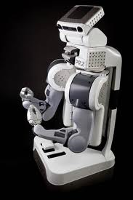
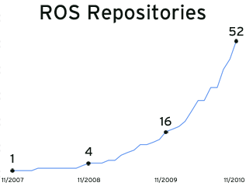
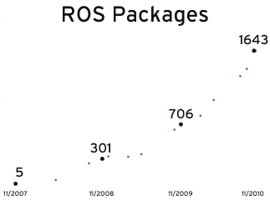
ROS
Headed up by Willow Garage
(http://www.willowgarage.com)
Three years old
(http://www.willowgarage.com/blog/2010/11/08/happy-3rd-anniversary-ros)
The software basis of Willow Garage’s PR2
Exponential adoption

Slide 7
So what is it?
A 'Meta' OS. Open Source!
  Sits on top of Linux (preferably Ubuntu)
  Windows implementation started
  (http://www.ros.org/wiki/cturtle/Installation/Windows)
Agent based
Message passing
  Publish / Subscribe
  Service (remote operation) invocation
Package Management
Name and Parameter Services
Programming Language Support
  C++
  Python
  Lisp?

Slide 8
So what is it? (cont.)
Low level device abstraction
  Joystick
  GPS
  Camera
  Controllers
  Laser scanners
  ...
Application building blocks
  Coordinate system transform services
  Visualization tools
  Debugging tools (e.g., recording)
  Robust navigation stack (SLAM with loop closure)
  Arm path planning
  Object recognition
  ...

Slide 9
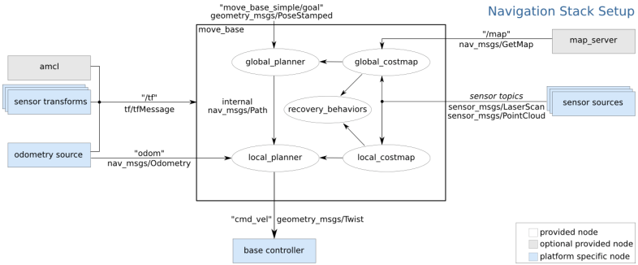
ROS Navigation Stack
from http://www.ros.org/wiki/navigation/Tutorials/RobotSetup

Slide 10
Where is it used?
More than 50 robots use ROS
(http://www.ros.org/wiki/Robots)
Including Hobby and Low-Cost Platforms
ROS now runs on many lower-cost, hobby-friendly platforms. 2010 started off with Andrew Harris providing ROS libraries for the Arduino and was quickly followed by I Heart Robotics's WowWee Rovio drivers. You can now use Lego NXT robots with ROS as well as Taylor Veltrop's drivers for Roboard-equipped humanoids. Companies have also contributed: Vanadium Labs provided ROS drivers for their ArbotiX line of robocontrollers.
The ROS iRobot Create/Roomba community has also expanded greatly this year, with many institutions and individuals now providing drivers and libraries: Brown's RLAB, CU Boulder's Correll Lab, Aptima, Stanford, OTL, and ISR - University of Coimbra.
From: http://www.willowgarage.com/blog/2010/11/08/happy-3rd-anniversary-ros

Slide 11
Key Concepts
roscore: Name and Parameter server; singleton
Package: A virtual directory holding one or more executables (nodes)
Node: An agent communicating with ROS and other nodes via
  Topics (publish / subscribe) using typed messages
  Services: Request / Response paradigm (think of method or operation) via typed messages

Slide 12
Utilities Demo
roscore
roscd
rosrun
roslaunch
rostopic
rxgraph
rosservice
rosparam
rosconsole / rxloggerlevel / rosout

Slide 13
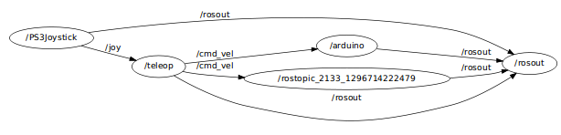
Communication Graph
rxgraph

Slide 14
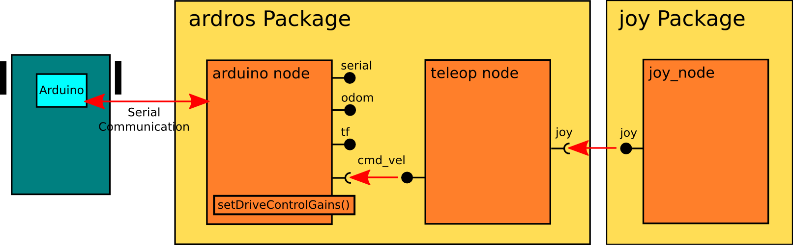
Python Implementation Demo

Slide 15
References
ROS wiki:
http://www.ros.org/wiki
Tutorials:
http://www.ros.org/wiki/ROS/Tutorials/
IREX 2009 Presentation
http://www.willowgarage.com/blog/2009/12/02/irex-2009-platform-personal-robotics?page=22
Willow Garage
http://www.willowgarage.com/
Happy 3rd Anniversary, ROS!
http://www.willowgarage.com/blog/2010/11/08/happy-3rd-anniversary-ros
ChiPy Presentation (ROS overview, emphasis on Python)
http://www.ros.org/news/2011/01/chipy-presentation-ros-overview-and-robomagellan-demo.html
Windows Support
http://www.ros.org/news/2011/01/chipy-presentation-ros-overview-and-robomagellan-demo.html
My own blog and web site
  http://www.hessmer.org/blog
  http://www.hessmer.org/

